Slide 1
Pending Meal
Sj101: Hilario.pagtalunan.salceda

Slide 2
What is Pending Meal

Slide 3
Features
User
Track stats and previous transactions
Preview images of people aided
Restaurant
Add pending order
By User
By Guest
Claim pending order
Capture image of happy moment

Slide 4
Sustainable Development goals
#2: No Hunger
#12: Responsible Consumption and Production

Slide 5

Home screen

Slide 6
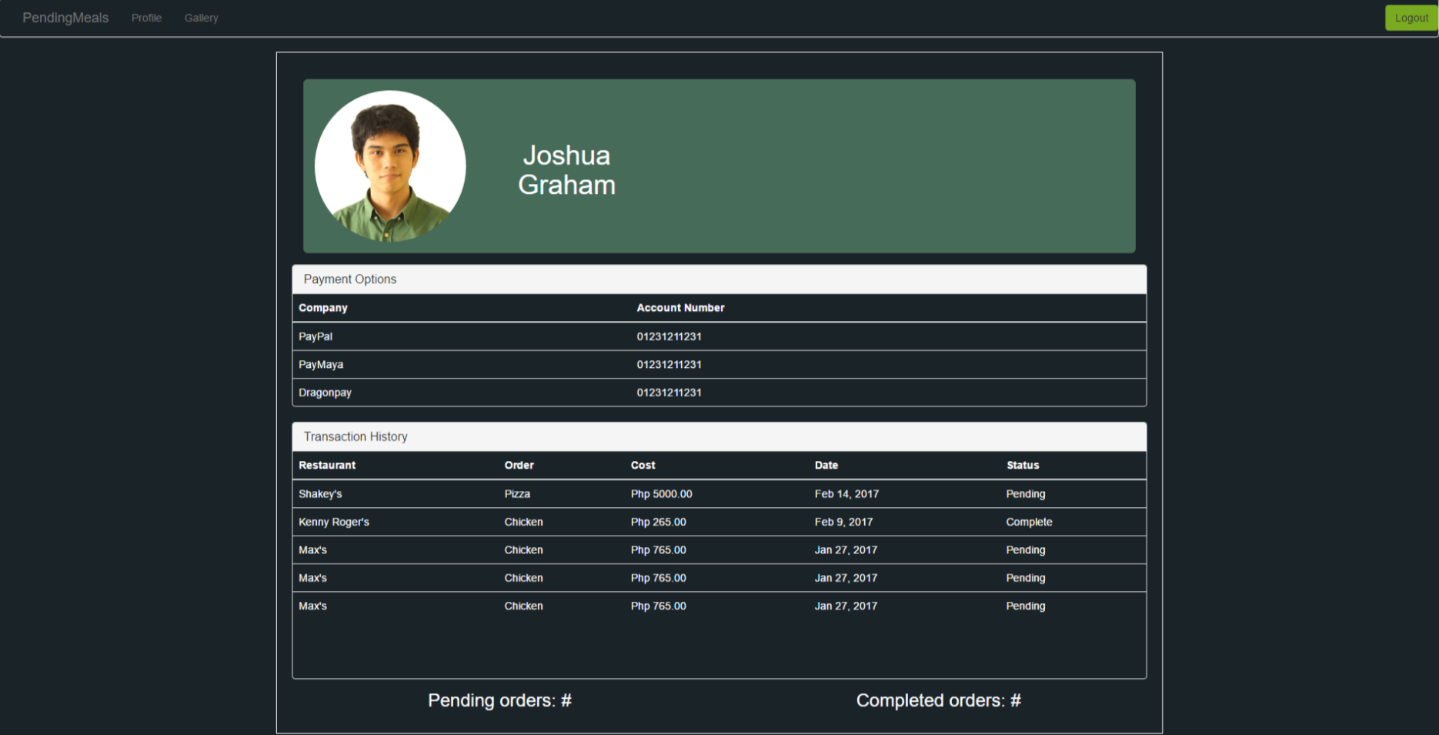
Customer screen

Slide 7
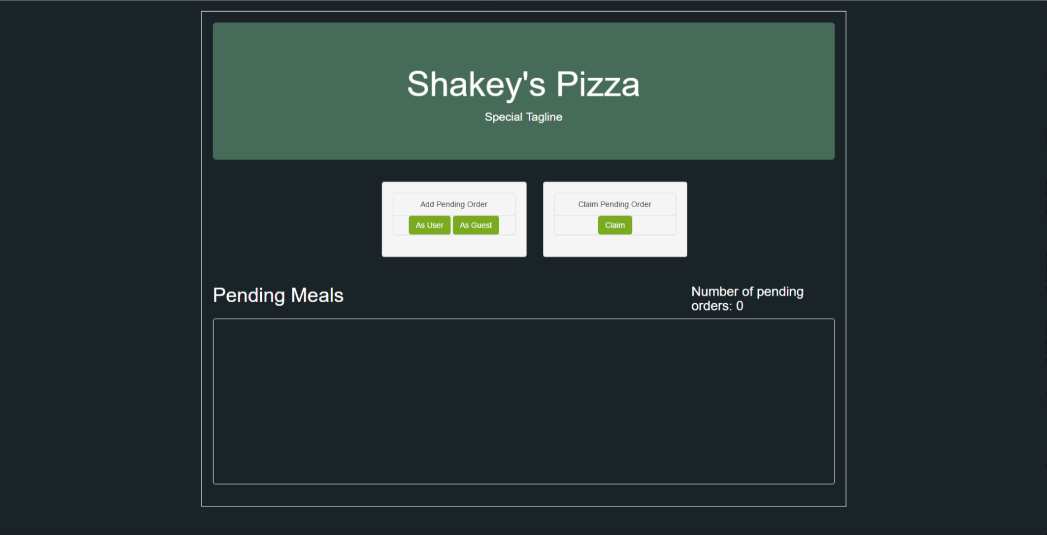
Restaurant screen

Slide 8
Questions?

Slide 9
Thank you!

